Slide 1
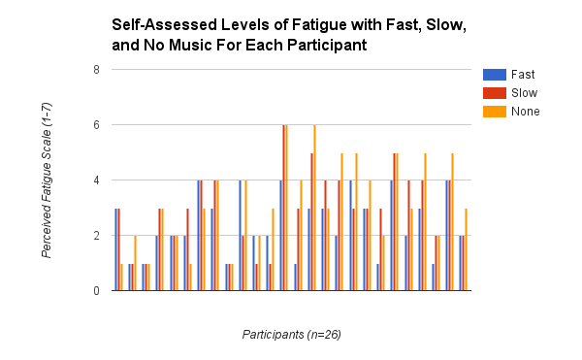




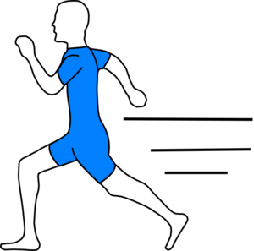


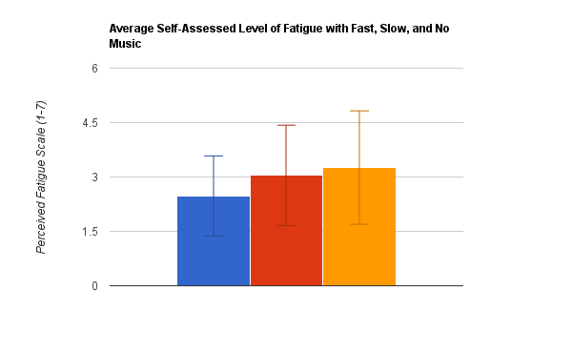




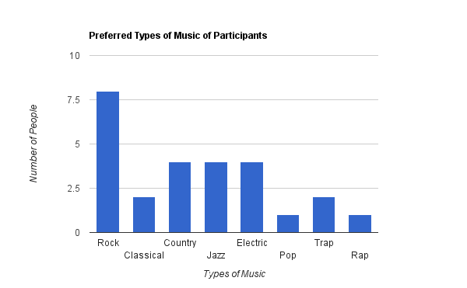
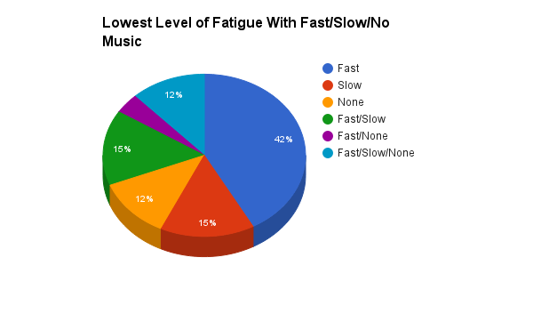


Introduction
Results
Discussion
Physiology affects mental reactions to music when exercising
(Furnham and Bradley, 1997)
Subjects’ heart rate increased the most with fast-paced music. (Dainow, 1977)
All types of athletes use music to keep them motivated and prevent fatigue (Brownley et al., 1995)
Ability to choose music based on personal preferences can affect physical and mental ability. (Brownley et al., 1995)
Eating before a sustained cognitive task reduced mental fatigue and improved performance afterwards . (Guo, W. et al. 2015)
Personal preferences may affect the impact of music on work performance. (Lesiuk, Teresa 2005)
As a general trend, fast music had a most beneficial impact on the athletes by decreasing the perceived fatigue during running exercise on a treadmill, while slow music having a lesser decrease when compared to the control group of no music (Figure 1 & 2). The average perceived level of fatigue for fast music was 2.4783. For slow music, the average was 3.0435 and for no music, it was 3.2609. We found that the results from our experiment between the Fast/Slow music and the Slow/No music were statistically similar.
This is because the p-value was .1278 for the Fast/Slow music group and .4783 for the Slow/No music group. Since both p-values are greater than .05, we accept the null hypothesis which states that the values are statistically similar. On the other hand, the results between the Fast/No music group is statistically different. However, the results may have been affected by each participant’s musical preference, as most testers preferred other types of music as opposed to classical music, which was used in this experiment (Figure 3).
Figure 1: Level of fatigue felt for each participant after going through each of the three trials: fast, slow, and no music (the control group). These tests were assigned in a random order and they were allowed to rest for as long as needed after each trial.
Conclusion
This experiment shows that listening to music while doing physical activities may help increase endurance in the listener. In the real world, this can be applied to people working strenuous physical jobs by using music to improve performance, perseverance, and persistence. Additionally, when working out at a gym, music may help them deal with fatigue better when lifting weights or using other exercise equipment.
Scientific Question
Figure 2: The mean of the level of self-assessed fatigue felt by all the participants within each trial. Fast music took the lead with the lowest fatigue levels, with slow music and no music lagging behind. Only the fast and control group are statistically different.
*
Future Work
How do different tempos of classical music affect the resistance to fatigue of athletes?
Hypothesis
In the future, different types of music can be used in each test for each person to determine whether musical preference truly has an impact on how well they resist fatigue. Additionally, lyrics in music could be tested to see if they are a factor in endurance while exercising.
If exposed to fast music, athletes will experience the most improvement in running endurance when compared to slow and no music.
Bibliography
Fast Music Slow Music Control
Brownley, Kimberly A., McMurray, Robert G., Hackney, Anthony C., “Effects of
music on physiological and affective responses to graded treadmill exercise
in trained and untrained runners” International Journal of Psychophysiology
19 (1995): 193-201.
Aloui, Asma et al. “Listening to Music During Warming-Up Counteracts the
Negative Effects of Ramadan Observance on Short-Term Maximal
Performance.” PLoS ONE 10.1371 (2015): 1-7.
Satoh, Masayuki et al. “The Effects of Physical Exercise with Music on Cognitive
Function on Elderly People: Mihama-Kiho Project.” PLoS ONE 10.1371 (2014)
1-8.
Guo, W., Ren, J., Wang, B., Zhu, Q. “Effects of Relaxing Music on Mental Fatigue
Induced by a Continuous Performance Task: Behavorial and ERPs Evidence.”
PLoS ONE 10.1371 (2015): 1-12.
Anshel, Mark H., and Marisi, Dan Q. “Effect of Music and Rhythm on Physical
Performance.” The Research Quarterly 49.2 (2013): 109-113.
Lesiuk, Teresa., “The Effect of Music Listening on Work Performance.”
Psychology of Music 33 (2005): 173-191.
Dainow, Elliot., “Physical Effects and Motor Responses to Music.” Journal of Research and Music Education 25.3 (1977): 211-221.
Methodology
Participants were selected that have been cleared by a doctor
4%
Each participant was given a pre-survey to acquire background information on that could affect the results.
They were tested in 3 trials for 5 minutes each at 6mph while using fast and slow orchestral music with no music as the control group
Figure 3: Category of music in which participants felt the lowest level of self-assessed fatigue. Most had the least fatigue with fast music playing.
Figure 4: Every participants’ musical preference. Most participants preferred rock music, while classical music ranked 5th behind most other genres of music.

